Slide 1
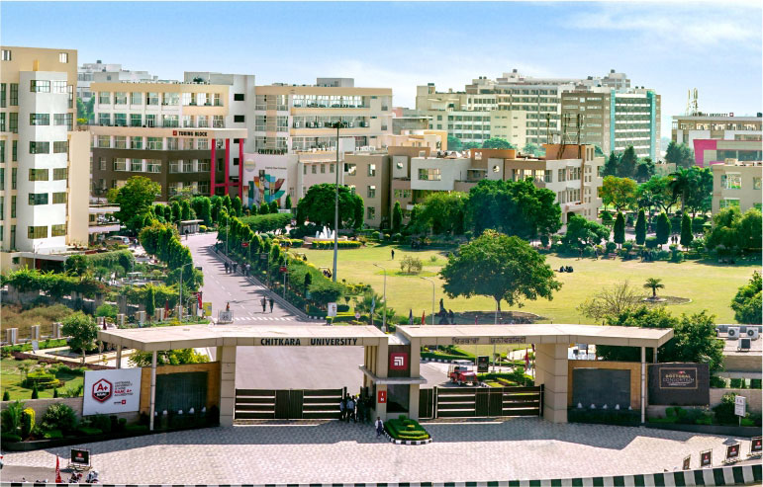
UPERMIT
- Your Key to Seamless Permitting!

Slide 2
Existing Problem
1
Provided solution
2
TABLE
OF CONTENTS
3 Panels: Student , Admin, Parent
3
Flow graph of the project
4
5
Conclusion

Slide 3
1. Limited Accessibility: The previous system only catered to hostel students, leaving out a substantial portion of the student body. This limited accessibility could have caused inconvenience and disparity among students who were not residing in hostels.
2. Inequality: By restricting the leave system to hostel students only, there might have been inequality issues arising among students. Non-hostel students might have felt unfairly treated or neglected compared to their hostel counterparts.
3. Administrative Burden: Handling leave requests manually or through disparate systems for different groups of students could have been administratively burdensome. This might have led to inefficiencies in managing leave applications and approvals.
4. Communication Gaps: With separate systems for different student groups, communication gaps could have emerged. Important updates, policy changes, or notifications related to leave management might not have reached all students uniformly.
5. Lack of Flexibility: The previous system might have lacked flexibility in accommodating the diverse needs and circumstances of all students. By expanding the project to include all students, you're offering a more adaptable solution that can cater to a wider range of situations.
EXISTING PROBLEM
Leaves taken by hostelers and non-hostelers

Slide 4
PROVIDED SOLUTION
Automated Leave Management System:
The UPERMIT project introduces an automated system to streamline the management of various types of leaves for students within a university. This addresses the current manual and time-consuming process of applying for and approving leaves, which is prone to errors.
Online Leave Submission:
The system allows students to submit their leave requests online, eliminating the need for physical paperwork and reducing administrative burden. This online submission process saves time for both students and administrative staff.
Quick Response Mechanism:
By enabling management to review and respond to leave requests quickly and conveniently, the project ensures efficient handling of leave applications. This quick response mechanism enhances student satisfaction and reduces delays in leave approval.
Enhanced Efficiency and Transparency:
By automating the leave management process and providing transparent communication channels, the project enhances the efficiency and transparency of university administration. This reduces administrative overheads and ensures fair and consistent handling of leave requests.
Three Panel Structure:
The project consists of three distinct panels - Student Panel, Parent Panel, and Admin Panel - each serving a specific purpose to facilitate the smooth functioning of the system. This structured approach ensures that all stakeholders, including students, parents, and administrative staff, can easily interact with the system according to their roles and responsibilities.

Slide 5
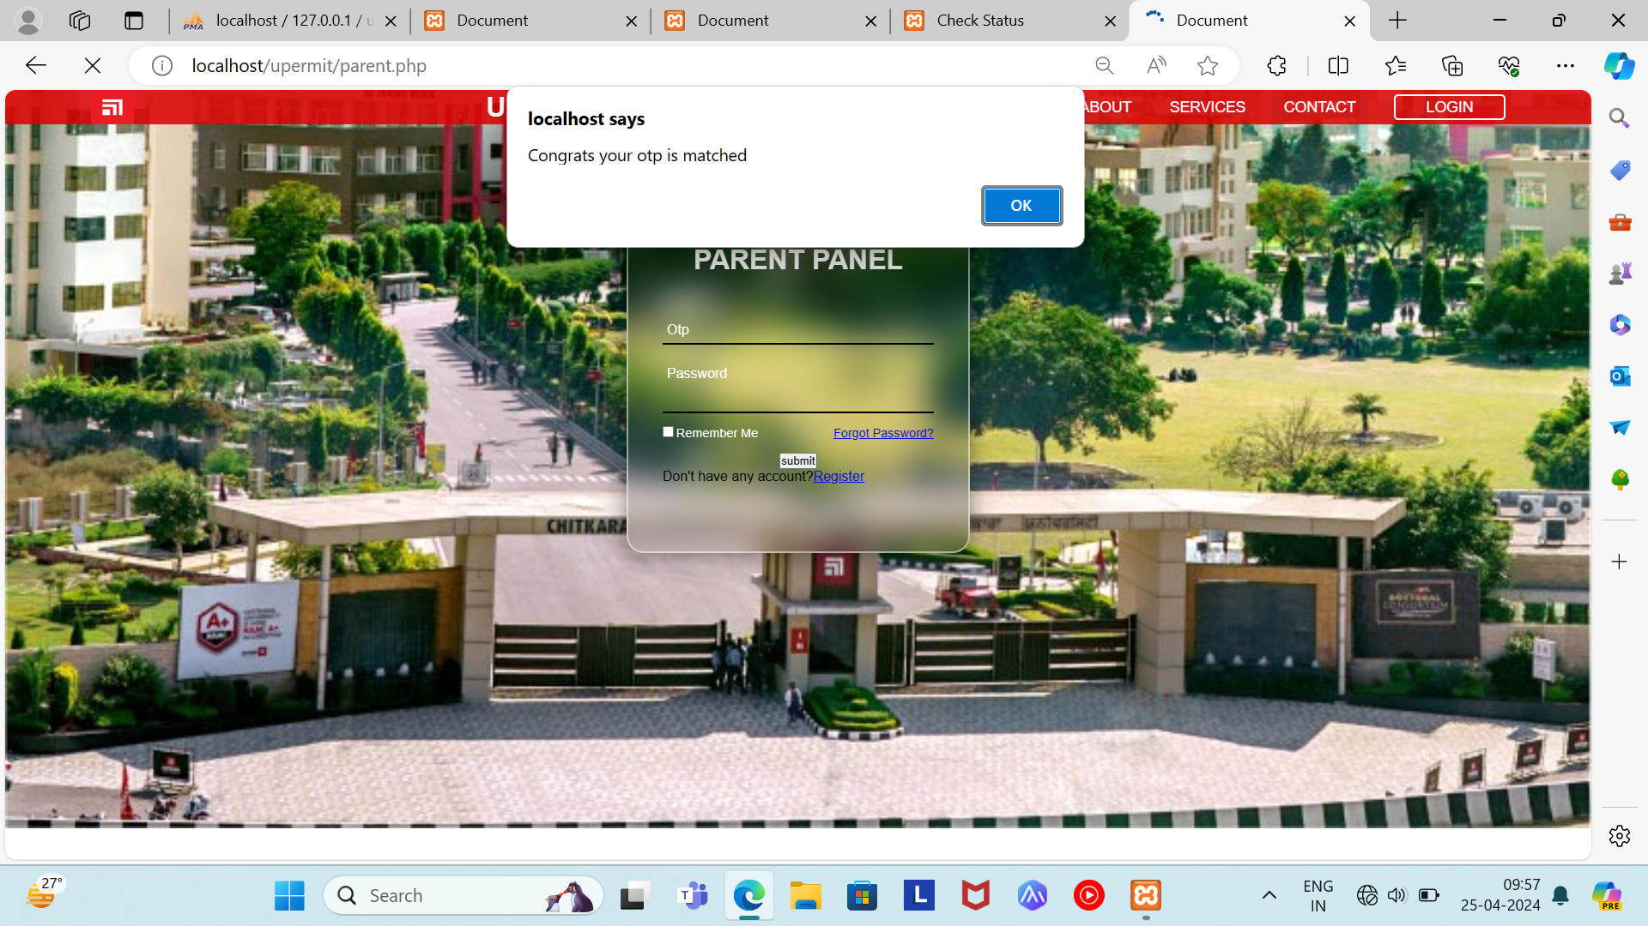
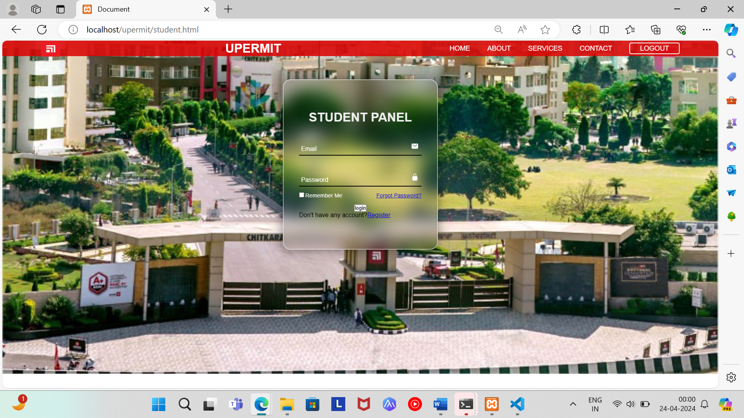

01
02
03
THE PARENT PANEL
THE ADMIN PANEL
THE STUDENT PANEL
3
The Parent Panel serves as the primary interface for parents. The parents will receive an otp which will be required for registration. This ensures that the credential of the parent is valid.
The Student Panel serves as the primary interface for students. In order to register, the student is required to enter a one-time password (OTP) sent to their parent portal. Without this OTP, the student will not be able to register. This verification process ensures the security and authenticity of the student's registration.
The Admin Panel has the authority to approve or reject leave requests. When a student applies for a leave, the Admin Panel reviews the request and decides whether to grant it. If the request is approved, the Admin Panel will share the Excel sheet with the parent, providing them with comprehensive information about their child's attendance and progress.
Launched in 2017, the intelligent transport management system is already helping develop efficient and convenient bus transport services and transform Ahmedabad into a world-class smart city.
The ITMS incorporates five smart transport sub-systems:
Automated Fare Collection Service (AFCS)
Automatic Vehicle Location System (AVLS)
Passenger Information System (PIS)
Vehicle Planning Schedule and Dispatch System (VPSD)
Depot Management System (DMS)
2
1

Slide 6
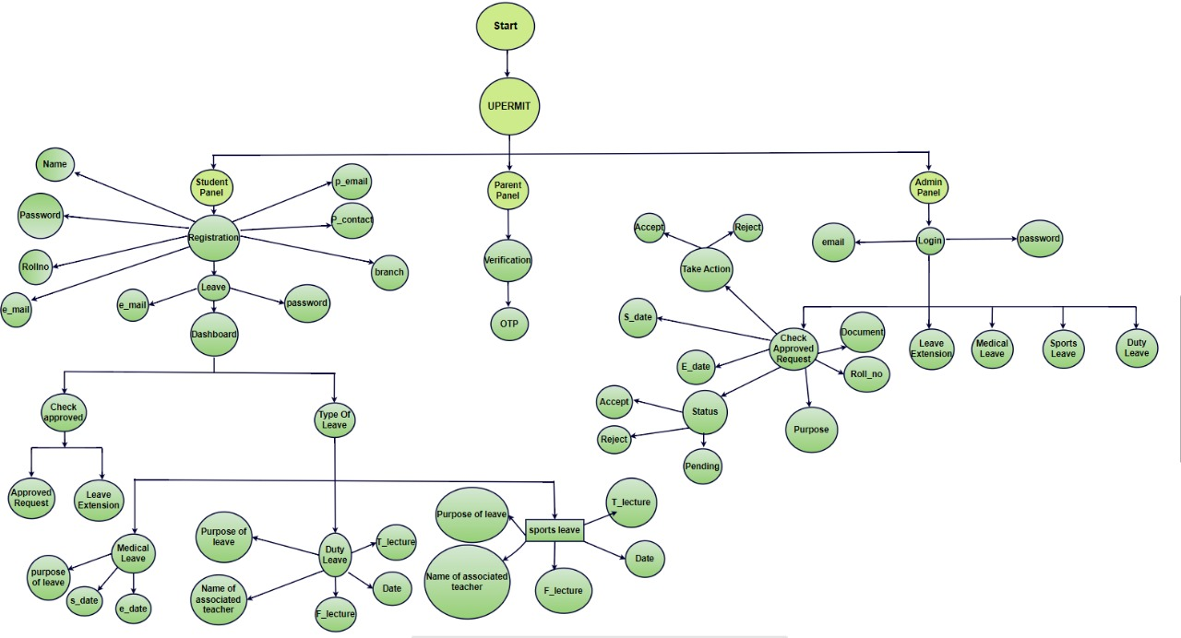
Control Flow Graph

Slide 7

In conclusion, the UPERMIT project revolutionizes leave management for university students, offering a streamlined and efficient system for both hostelers and non-hostelers alike. By automating the process and facilitating communication between students, parents, and administrators, UPERMIT enhances transparency, efficiency, and collaboration within the university community.

Slide 8

Presented By:
Mehardeep Kaur
Roll no. 2210997287
Swati Thakur
Roll no. 2210997249
Simran Kaur
Roll no. 2210997236
Please visit www.upermit.in/register.html

